Slide 1

Christian 101
5:15 – 21
Week 25
20 July 2022

Slide 2

Ephesians ch5 overview
As the days are evil and the time is short, Christians must “walk as wise” and make the best use of their time. This requires an understanding of the Lord’s will.
Christians are also to be filled with the Spirit, as evidenced by singing together, praying with thanksgiving, and submitting to one another in the fear of God (15-21).

Slide 3

“Christian 101”

Slide 4
Ephesians 5:15 – 21
At times it helps to return to the very basic. Life gets complicated, things get convoluted, and we get confused. When that happens, it helps to distinguish the essentials from the nonessentials as we return to the fundamental building blocks of Christian living. This is exactly what we find in Ephesians 5:15-21. Let’s consider it “Christian Living 101.”
For most of us, the following five basic principles are nothing new. They’re reminders of essential truths. For others, however, they serve as an introductory course for the Christian life—a primer on how to live out our faith in a faithless world.

Slide 5
Ephesians 5:15 – 21
In the previous section we saw that Christians are commanded to be light in the dark world. In this section, Paul again emphasizes the walk of the believer as he or she is led and empowered by the Holy Spirit.
The truths in this section are as foundational for seasoned saints as they are for baby believers. So let’s take Paul’s hand as he leads us through five primary principles of the Christian life:
1 – The Conduct Principle (5:15)
2 – The Time Principle (5:16)
3 – The Decision-Making Principle (5:17)
4 – The Control Principle (5:18-20)
5 – The Submission Principle (5:21)

Slide 6
Ephesians 5:15
¹⁵See then that ye walk circumspectly, not as fools, but as wise,

Slide 7
Ephesians 5:15
The first of Paul’s five basics of Christian Living 101 is the conduct principle. Paul says believers must walk with care and wisdom. He’s not talking about where you’re walking or how fast, but the manner in which you walk.
This is the principle of right conduct in the everyday Christian life. As in tightrope walking, the main concern is the quality of the walk—maintaining balance and avoiding a fall. In Scripture, lacking wisdom means living as if God didn’t exist (Ps. 14:1).
It means conducting everyday affairs with no concern for God . . . as if His perspective on the mundane matters of life were not relevant.

Slide 8
Ephesians 5:15
Walking with care and wisdom, however, means acknowledging the Lord in all of our ways (Prov. 3:6). It means being ever conscious of His concern for us and His desire to see us conducting our lives in a manner worth of our calling in Christ > “As a prisoner for the Lord, then, I urge you to live a life worthy of the calling you have received” (Eph. 4:1).

Slide 9


Slide 10
Ephesians 5:16
¹⁶Making the most of every opportunity, because the days are evil.

Slide 11
Ephesians 5:16
Paul’s second basic foundation stone of Christian living is the time principle. The phrase “making the most of” is a participle indicating a way in which one accomplishes the first action. That is, in order to walk with care and wisdom, we must work at “redeeming the time” (KJV).
The word translated “time” suggests the idea of “opportunities.” The participle itself refers to purchasing, buying back, or even rescuing. That is, “rescuing [opportunity] from waste or abuse.”
Just as Christ redeemed us, rescuing us from a futile existence enslaved to sin and empowering us to live lives of purity and purpose, we ought to buy back our time from futility and sin, turning our everyday opportunities toward His purpose.

Slide 12


Slide 13
Ephesians 5:16
In another place Paul covers all the bases when he said, “Whether, then, you eat or drink or whatever you do, do all to the glory of God” (1Cor 10:13).
As frail and fallen humans, each of us is subject to extremes. At times we either waste our time or become borderline neurotic about it. We’re either procrastinators or workaholics. The first extreme passively resists God’s purposes for our lives; the second disregards the joy of peace and rest.
What can we do to counter these extremes? We can overcome procrastination with discipline—directing our energies into what really matters. Discipline means prioritizing and planning, staying focused on the goal, and not losing sight of God’s purpose.

Slide 14
Ephesians 5:16
We overcome the extreme of restless workaholism with discernment—recognizing that we were not created as machines to accomplish endless tasks but as works of art molded by God’s own hands to serve and glorify Him (Gen. 1:26-27; 2:7).
He made us to experience meaningful relationships with Him and with others, all the while appreciating His beautiful creation. We must remind ourselves that the work of God’s kingdom consists of more than just labor.
Paul gives a straightforward reason for making the most of every opportunity without procrastination or over-ambitiousness: “because the days are evil” (5:16).

Slide 15
Ephesians 5:16
This can be understood in two ways. It may be that we need to use our time wisely and carefully in order to counter the evil in this world.
Or it may refer to the way the evil world tempts us toward wasting our time on frivolous entertainment, fruitless pursuits, or fragmented activities.
In either case, the solution is the same: Redeem the time!

Slide 16


Slide 17
Ephesians 5:17
¹⁷Therefore do not be foolish, but understand what the Lord’s will is.

Slide 18
Ephesians 5:17
Paul’s third basic foundation for Christian Living 101 is the decision-making principle. Building upon the principle of living with cautious wisdom (5:15) and using time wisely (5:16), Paul introduces this principle with a reminder: “Do not be foolish” (5:17).
Remember, the quintessential fool is the person who says, “There is no God” (Ps. 53:1), then lives his or her life accordingly.
Therefore, to the degree that we live as if God were not present in our lives, not interested in our decisions, and not worthy of our attention, we’re living as fools. Instead of living foolishly, we must “understand what the will of the Lord is” (5:17).

Slide 19
Ephesians 5:17
Few things in the Christian life are more basic or important that this—discerning God’s will for our lives. Numerous books have been written by people offering an oversimplified combination to unlock the secret safe of God’s will. Many people make it sound like God’s will for our lives is some kind of fixed path that we can know and follow with certainty.
Others have suggested that God’s will is—and always remains—a complete mystery, so we should just make our decisions, do whatever we want, and hope for the best. But both the absolutely fixed and absolutely free approaches to God’s will lack balance.

Slide 20


Slide 21
Ephesians 5:17
The truth is, Scripture gives us a number of clear indications of God’s expressed, revealed will for our lives. Let’s examine a few:
“And do not be conformed to this world, but be transformed by the renewing of your mind, so that you may prove what the will of God is, that which is good and acceptable and perfect” (Rom. 12:2).
“For the sorrow that is according to the will of God produces a repentance without regret, leading to salvation, but the sorrow of the world produces death” (2Cor. 7:10).
“For this is the will of God, your sanctification; that is, that you abstain from sexual immorality” (1Thes. 4:3).

Slide 22
Ephesians 5:17
Paul says we are to reject the pattern of this world. Be transformed. Renew your mind. Endure sorrow unto repentance. Be sanctified. Abstain from sexual immorality. Submit to human authorities. Do what’s right. These are just a few simple, straightforward, clear, and objective expressions of the will of God for our lives.
If we spend our time pursuing the things that God explicitly wills for us in Scripture, we won’t do the things that are against His will. Moreover, when we pursue these things the Spirit of God creates in us character and virtues that help us more easily discern the will of God in areas that are not clearly revealed.

Slide 23
Ephesians 5:17
There are two tendencies regarding our response to God’s will: Either we run ahead of Him or we resist Him. The first is caused by a lack of patience and prudence. We jump to conclusion, rush into decisions, or tumble headlong into every opportunity that presents itself.
However, when it comes to God’s specific, personal, and often subjective will for our lives, such as choosing a career, a mate, a home, or a church, we get rather creative in the ways we run ahead of God. Some of us employ the “plop and point” method, letting our Bible fall open and randomly pointing our finger at a verse to guide the day’s choices.
Or we decide that a string of green or red traffic signals is a divine sign. This kind of superstitious hocus-pocus is the very thing Paul warns us against.

Slide 24
Ephesians 5:17
Don’t look for the face of Jesus in an enchilada or lie awake, listening for sounds in the night—three clicks and bump! That’s “voodoo theology.” Though popular, that kind of nonsense is far removed from how God would have us perceive His will.
The second extreme—resisting God’s will—comes as a result of pride. We dichotomize between “sacred” and “secular,” banishing God from the latter. We stubbornly ignore the clear mandates of Scripture, finding all kinds of reasons why they don’t apply to us.
Following God’s lead involves a simple, though by no means quick-and-slick, method. Pray. Seek Him humbly, sincerely, and patiently with an open , willing heart.

Slide 25
Ephesians 5:17
If you don’t have a willing heart, start there: Pray for one. Go to His Word prayerfully and intelligently, thinking through all your decisions in light of biblical principle and in line with His clearly revealed will for everyone.
Seek the counsel of wise and seasoned Christians, ideally those who have gone through the process of making similar decisions. Listen most closely to those who are objective, who personally have nothing to gain or to lose by your decision.
Then, when you become convinced of God’s illuminating light, step forward in humble faith and trusting obedience. We may not always perceive every facet of God’s will—it often includes some surprises—but what matters most is walking as best we can in His revealed light.

Slide 26
Ephesians 5:18 – 20
¹⁸Do not get drunk on wine, which leads to debauchery. Instead, be filled with the Spirit, ¹⁹speaking to one another with psalms, hymns, and songs from the Spirit. Sing and make music from your heart to the Lord, ²⁰always giving thanks to God the Father for everything, in the name of our Lord Jesus Christ.

Slide 27
Ephesians 5:18 – 20
This now brings us to the control principle—the fourth basic teaching of the Christian life. Paul begins this exhortation with a contrast—being drunk and out of control versus being under the Spirit’s control. This is the difference between having our minds depressed and our senses numbed versus having them invigorated and stimulated.
People who are controlled by too much alcohol waste their time, squander their resources, and make fools of themselves. When people are drunk, the things they say usually profit no one. Their words are either garbled and slurred nonsense or full of coarse vulgarities.

Slide 28
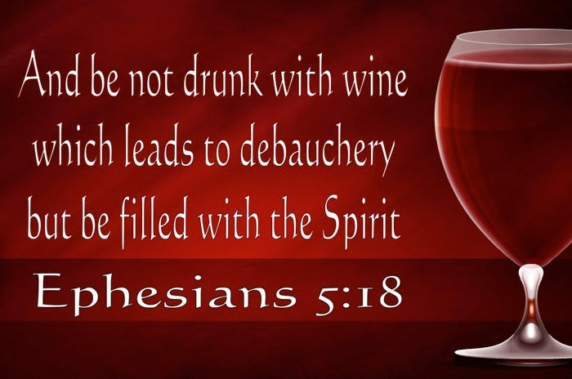

Slide 29
Ephesians 5:18 – 20
Contrast the drunk person with people who are controlled by the Spirit. Their minds are clear to see all that Christ has done and is doing. Their hearts are filled with joy as their lips overflow with praise. The Spirit of God fills their hearts with gratitude as their mouths speak in “psalms and hymns and spiritual songs” (5:19).
In fact, their entire lives are directed to God the Father through the Lord Jesus Christ (5:20) and by the power of the Holy Spirit.
How are we filled with the Spirit? We see His effects in Ephesians 5:19-20, but is there anything we can do to promote these?

Slide 30
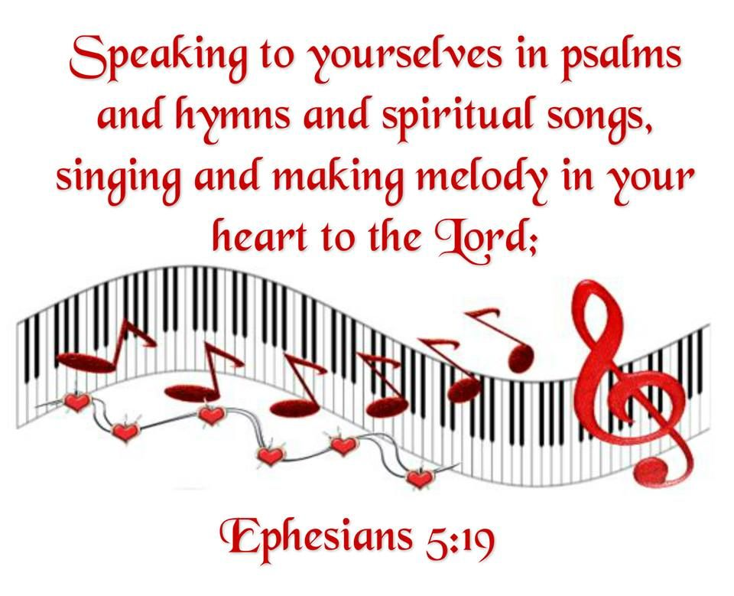

Slide 31
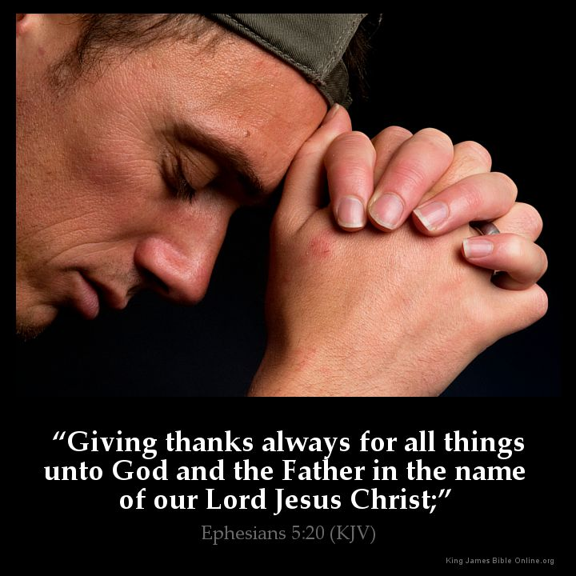

Slide 32
Ephesians 5:18 – 20
The phrase, “be filled with the Spirit” (5:18) means we are to allow the Spirit to fill us with all of His blessings, empower us with His enablement, and lead us in His ways.
Our whole lives, yielded to God, are to overflow with the work of the Holy Spirit.
Swindoll quoting Harold Hoehner says, “With the indwelling each Christian has all of the Spirit, but the command to be filled by the Spirit enables the Spirit to have all of the believer.”

Slide 33


Slide 34
Ephesians 5:21
²¹Submit to one another out of reverence for Christ.

Slide 35
Ephesians 5:18 – 20
Finally, Paul’s fifth foundation of the Christian life is the submission principle. This reminds us of a vital yet frequently forgotten fact of the Christian life: We’re not meant to live alone. We’re meant to subject ourselves to one another, “bearing one another’s burdens” (Gal. 6:2), encouraging one another in love and good works (Heb. 10:24-25), and looking out for one another’s interest (Phil. 2:3-4).
Think about it, if your Christianity is making you more of a recluse, its not true Christianity; it’s selfishness. If what you are calling the Christian life is pulling you further and further away from others, you need to go back to the basics of Christian Living 101.

Slide 36


Slide 37
Ephesians 5:18 – 20
We are to be subject to one another “in the fear of Christ (5:21). Because we love, respect, and honor Christ, we are to love, respect, and honor others. It’s that simple.
In the final analysis, if our Christian walk doesn’t lead us into deeper and more meaningful relationships with fellow believers, we’ve missed the mark.
So important is this principle of submissive service to one another that Paul spends much of the rest of the letter dealing with how this principle is supposed to work in specific areas of our lives. These include the realms of marriage, parenting, and even employment. Because Paul goes into such depth on those topics, we’ll deal with them separately.

Slide 38



Slide 39
NEXT CLASS – 27July 2022
Book of Ephesians
Before next class, read the below verses in the NIV and in one other versions of the Bible, i.e., NKJV, NRSV, KJV, CEV, etc …
Chapter 5:22 – 33
“Solving The Mystery of Marriage”

